Slide 1


SOCIAL INNOVATION IN PRACTICE
COLLEGE BUS TRACKING
TEAM-12
19H51A0264-C.Chandra Pavaneswara Reddy
19H51A0280-K.Sai Rishitha
19H51A0296-P.Varshitha
20H55A0207-Divya
20H55A0222-Chandan
GUIDENCE:
Archana Bathula(CEER/CSE)
P. Mahesh babu(CEER/MECH)
P.Ambica(CEER/EEE)

Slide 2

TEAM - 12
CONTENT :
To help students to reach college on time , without any troubles .
Students can see their college buses GPS location .
They can manage time and be ready in their bus stops .

Slide 3
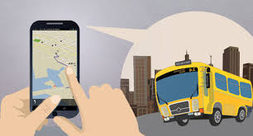
TEAM - 12
INTRODUCTION :
In our project we use GPS to the buses , to see the GPS location of the College buses .
We make users to see the College buses GPS location in their mobile .

Slide 4
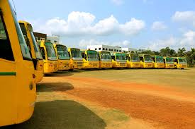

TEAM - 12
Existing Model :
The college have their own buses , but they don't have the location tracking .

Slide 5
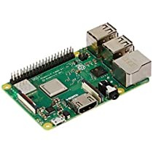
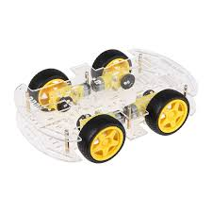
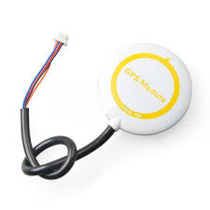

TEAM - 12
Components We Used :
RASPBERRY PI
CAR MODULE FOR COLLEGE BUS
G.P.S MODULE

Slide 6

TEAM - 12
SERVICES We Used :
Fire Base

Slide 7
TEAM - 12
Raspberry pi :
The Raspberry pi is a low cost , credit-card sized computer.
The Raspberry pi has a tool to create or to communicate by sending and receiving the information .

Slide 8
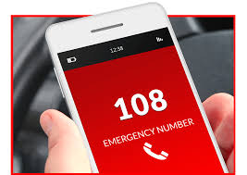
TEAM - 12
Car Module :
This Arduino car model , which we are using it for as bus .

Slide 9
TEAM - 12
G.P.S Model :
This GPS module helps to give coordinates of longitude and latitude .
This module is connected to raspberry pi to send information to the server , About the location of the bus .

Slide 10
TEAM - 12
Fire Base Services :
This is Google free web Server Services.
This we use for our Application to store users data and to communicate with internet .

Slide 11

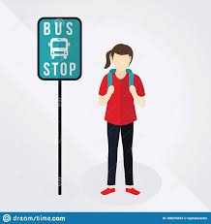
TEAM : 12
FLOW CHART :
Bus start going to the students bus stops location.
Buses start from their location
01
02
They can open and check the buses location in the mobile application , by this they will know where the bus is .
If the bus still not arrived at the location of students bus stops .
03
04

Slide 12
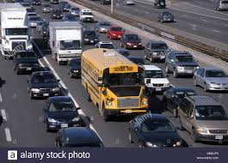
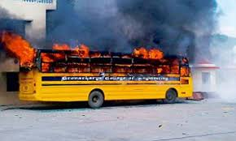
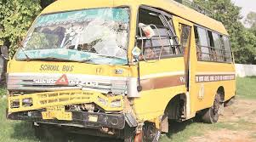
TEAM - 12
01
THERE ARE DIFFERENT SCENARIOS THAT COLLEGE BUS MAY HAVE IN SOME PROBLEM , WHILE IT REACHING TO THE STUDENTS BUS STOPS . THESE ARE THE SOME SCENARIOS THAT A BUSES MAY FACE .
02
Buses problems
03

Slide 13
TEAM - 12
ADVANTAGE :
Students are able to get the college bus location data .
They can manage time with this information .
DIS-ADVANTAGES :
Just they are able to know only the location of the bus information.

Slide 14
TEAM - 12
CONCLUSION :
By using this application , Students we be benefited .
Especially this project helps to the Students and Faculty in any accident or Late time situation , So they don't waste much time .

Slide 15
THANK YOU

